Slide 1
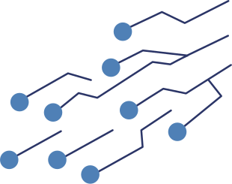

Petguard
Emergency Care at the Tap of a Paw
By: Steven Fitzgerald, Rhea Malpekar, Venkata Pavan Ganesh Pallothu, Kyle Henry, Spandan Mahat

Slide 2
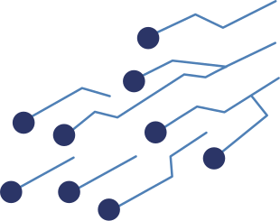

Overview
PetGuard is a mobile application built using React Native and Firebase.
It supports reporting of animal-related emergencies and non-emergency service requests.
The main idea is to provide a simple and fast way for users to submit service reports with location and photo evidence as well as tracking the request status.

Slide 3
Problem
Lack of a comprehensive app that does everything pet care related.
Competitors:
myVCA (can’t sign in without special access)
Animal Help Now (Auto location detection and other features, but old ui. For wild animals)
PawBoost (only for lost/found animals)

Slide 4
What PetGuard tries to achieve
The app tries to make animal emergency and service reporting fast, simple, and reliable on mobile devices.
Lets users sign in, report an animal emergency/non-emergency, add location and photos, submit the request, and track it after submission.
Features like emergency detection, offline saving, and later sync.
Anonymous guest user reporting.

Slide 5
Splash screen/Register screen
Built the splash screen as the app entry screen after launch.
Added logo, title, tagline, and loading spinner animations using React Native Animated.
Register screen asks for full name, email, phone number, password, confirm password, and acceptance of terms and conditions.
Used createUserWithEmailAndPassword() in AuthService to create the auth account.
Stored fields like uid, email, fullName, phoneNumber, and timestamps in the users collection.

Slide 6
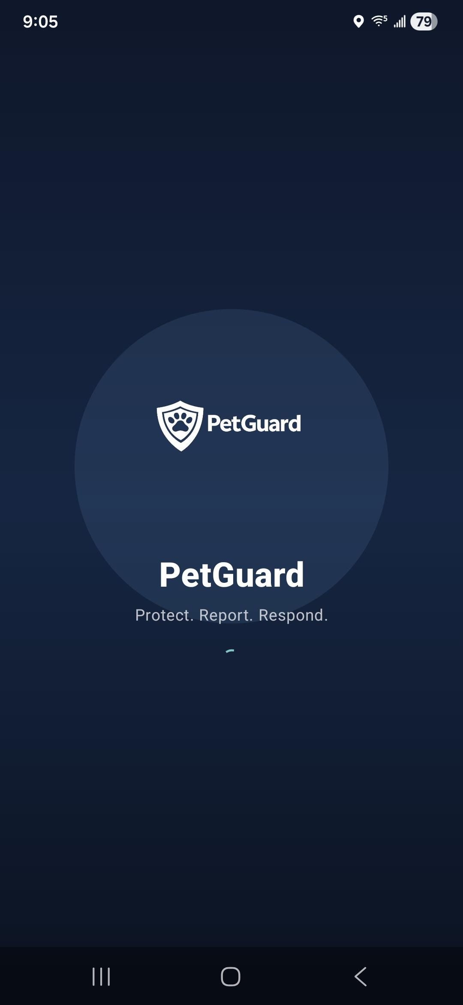
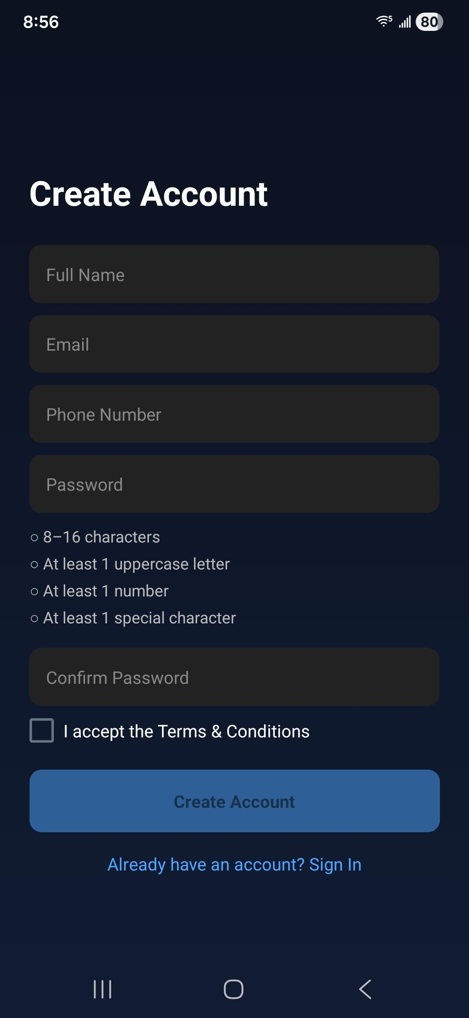
Splash screen/Register screen

Slide 7
Login screen
Used signInWithEmailAndPassword() inside AuthService for normal login.
Cannot access any of the screens unless logged in successfully.
Guest login is handled through AuthContext.
Added input validation on the screen before any backend call.
On web, used local persistence if Remember Me is checked.
On web, used session persistence if Remember Me is not checked.
On mobile, used persistent auth storage for remembered sessions and in-memory auth when not remembered

Slide 8
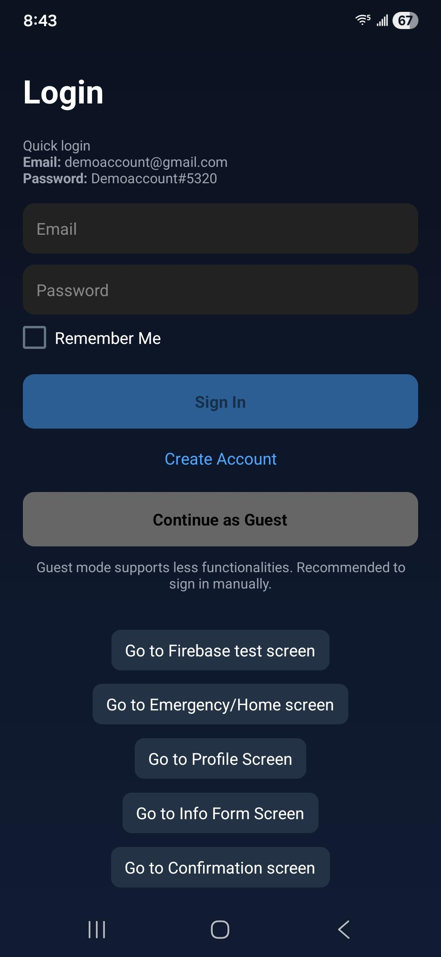
Login screen

Slide 9
Home Screen
Emergency options: Sick Animal, Car Accident, and Animal Cruelty.
Non-emergency options: Vaccination, Adopt / Surrender, and Spay / Neuter.
Used SafeAreaView and ScrollView as the main layout so the full dashboard fits on mobile screens.
Pulled the current user from AuthContext and Firebase auth to know who is signed in.
Showed a personalized welcome message using the user’s name, or Guest User for anonymous login.
Loaded profile data inside useEffect() when the screen mounts or when the user changes.

Slide 10
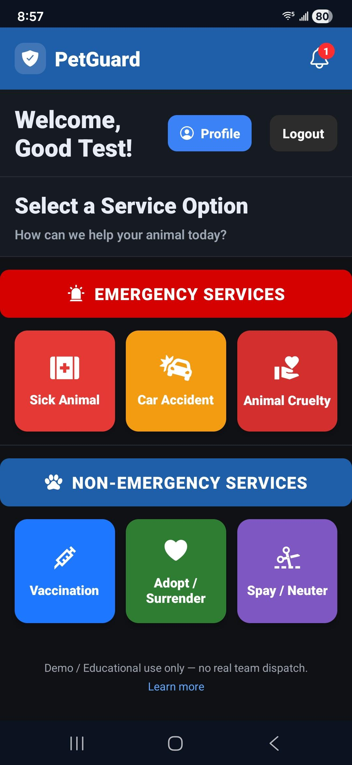
Home Screen

Slide 11
Profile screen/Navigation
The profile screen includes three main tabs: Profile, History, and Settings.
Loads user’s name from the firebase and welcomes them
Checked whether the current user is anonymous with user?.isAnonymous
Three tabs: Profile, History and Settings
Calls getUserProfile(uid) to get user data
Used cached profile data as a fallback if live profile loading fails.
Used a dedicated loadHistory() function to fetch the user’s requests.
Called deleteUserAccount() from ApiService after final delete confirmation.

Slide 12
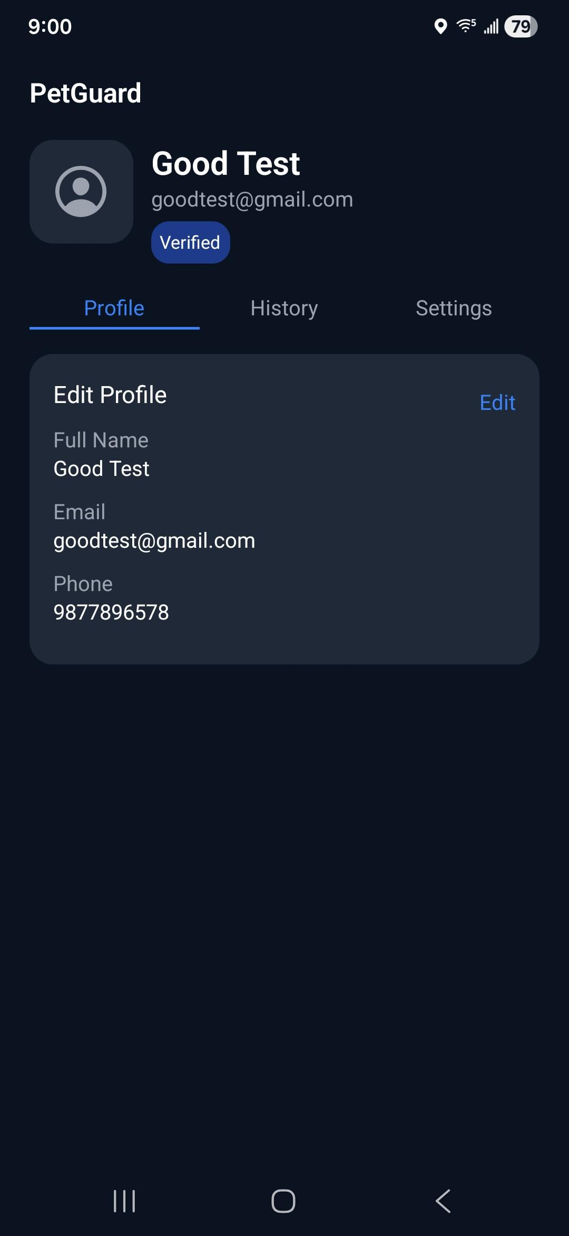
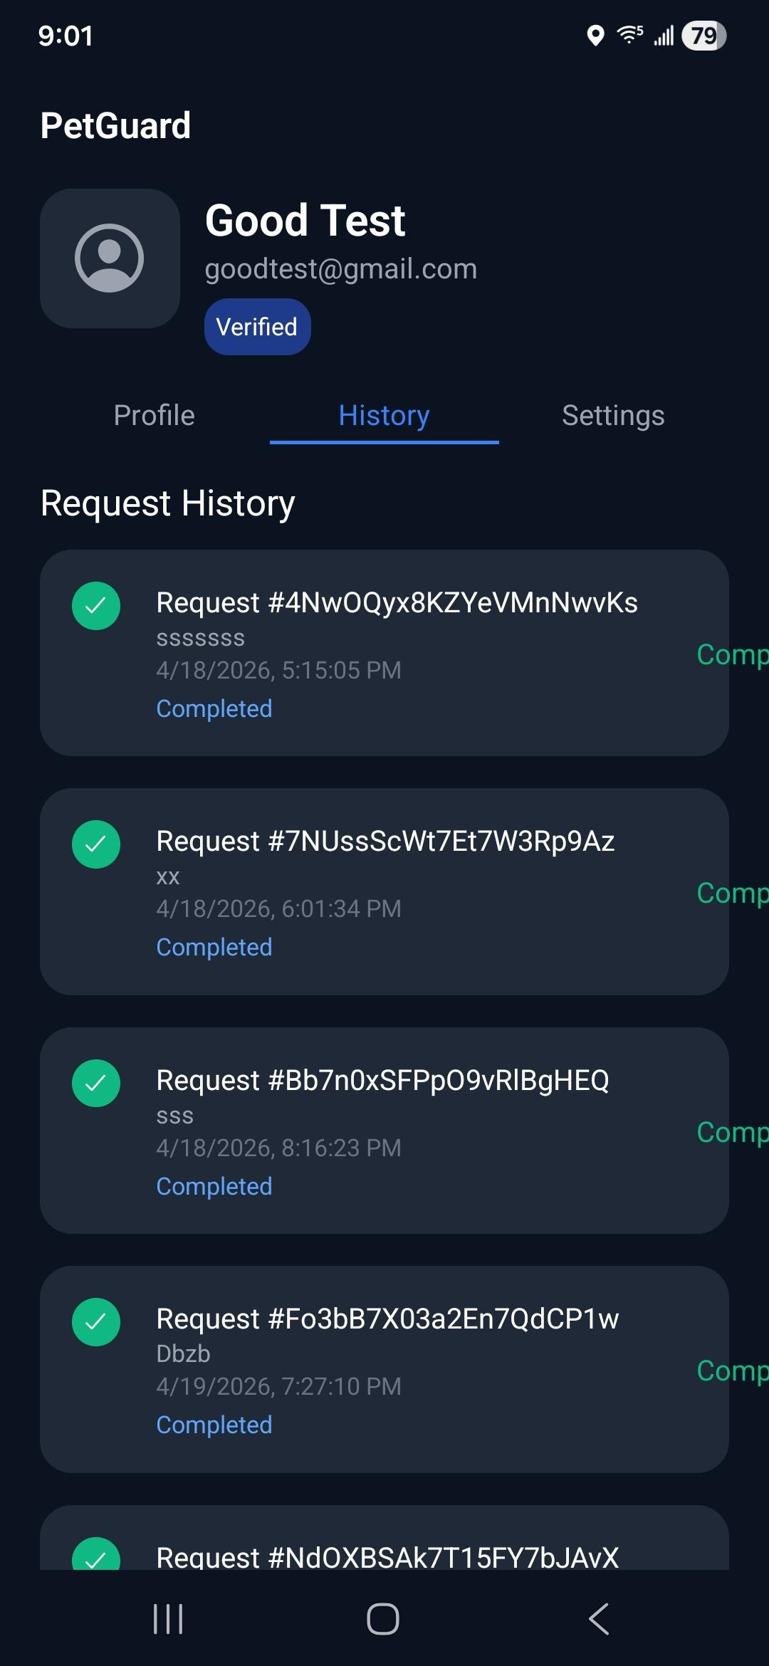
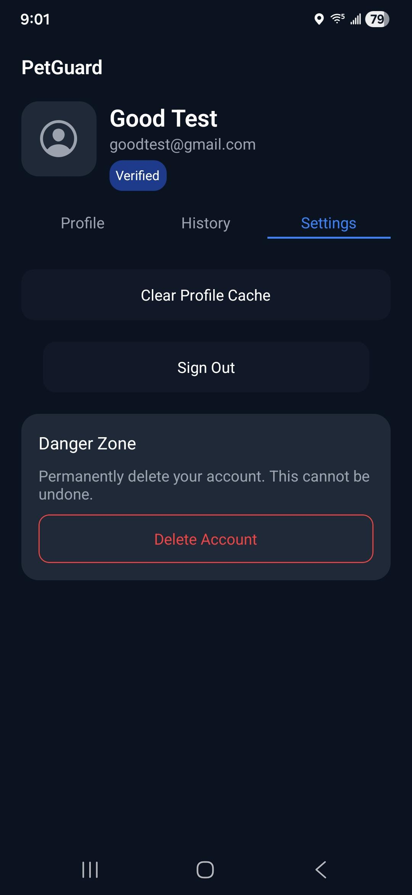
Profile screen/Navigation

Slide 13
Emergency Screen
The emergency home screen includes the main emergency entry points: Sick Animal, Car Accident, and Animal Cruelty.
That detection logic combines emergency type and description into one text input and checks for known scenario keywords.
The system compares matching scenarios by severity priority and chooses the highest-risk match.

Slide 14
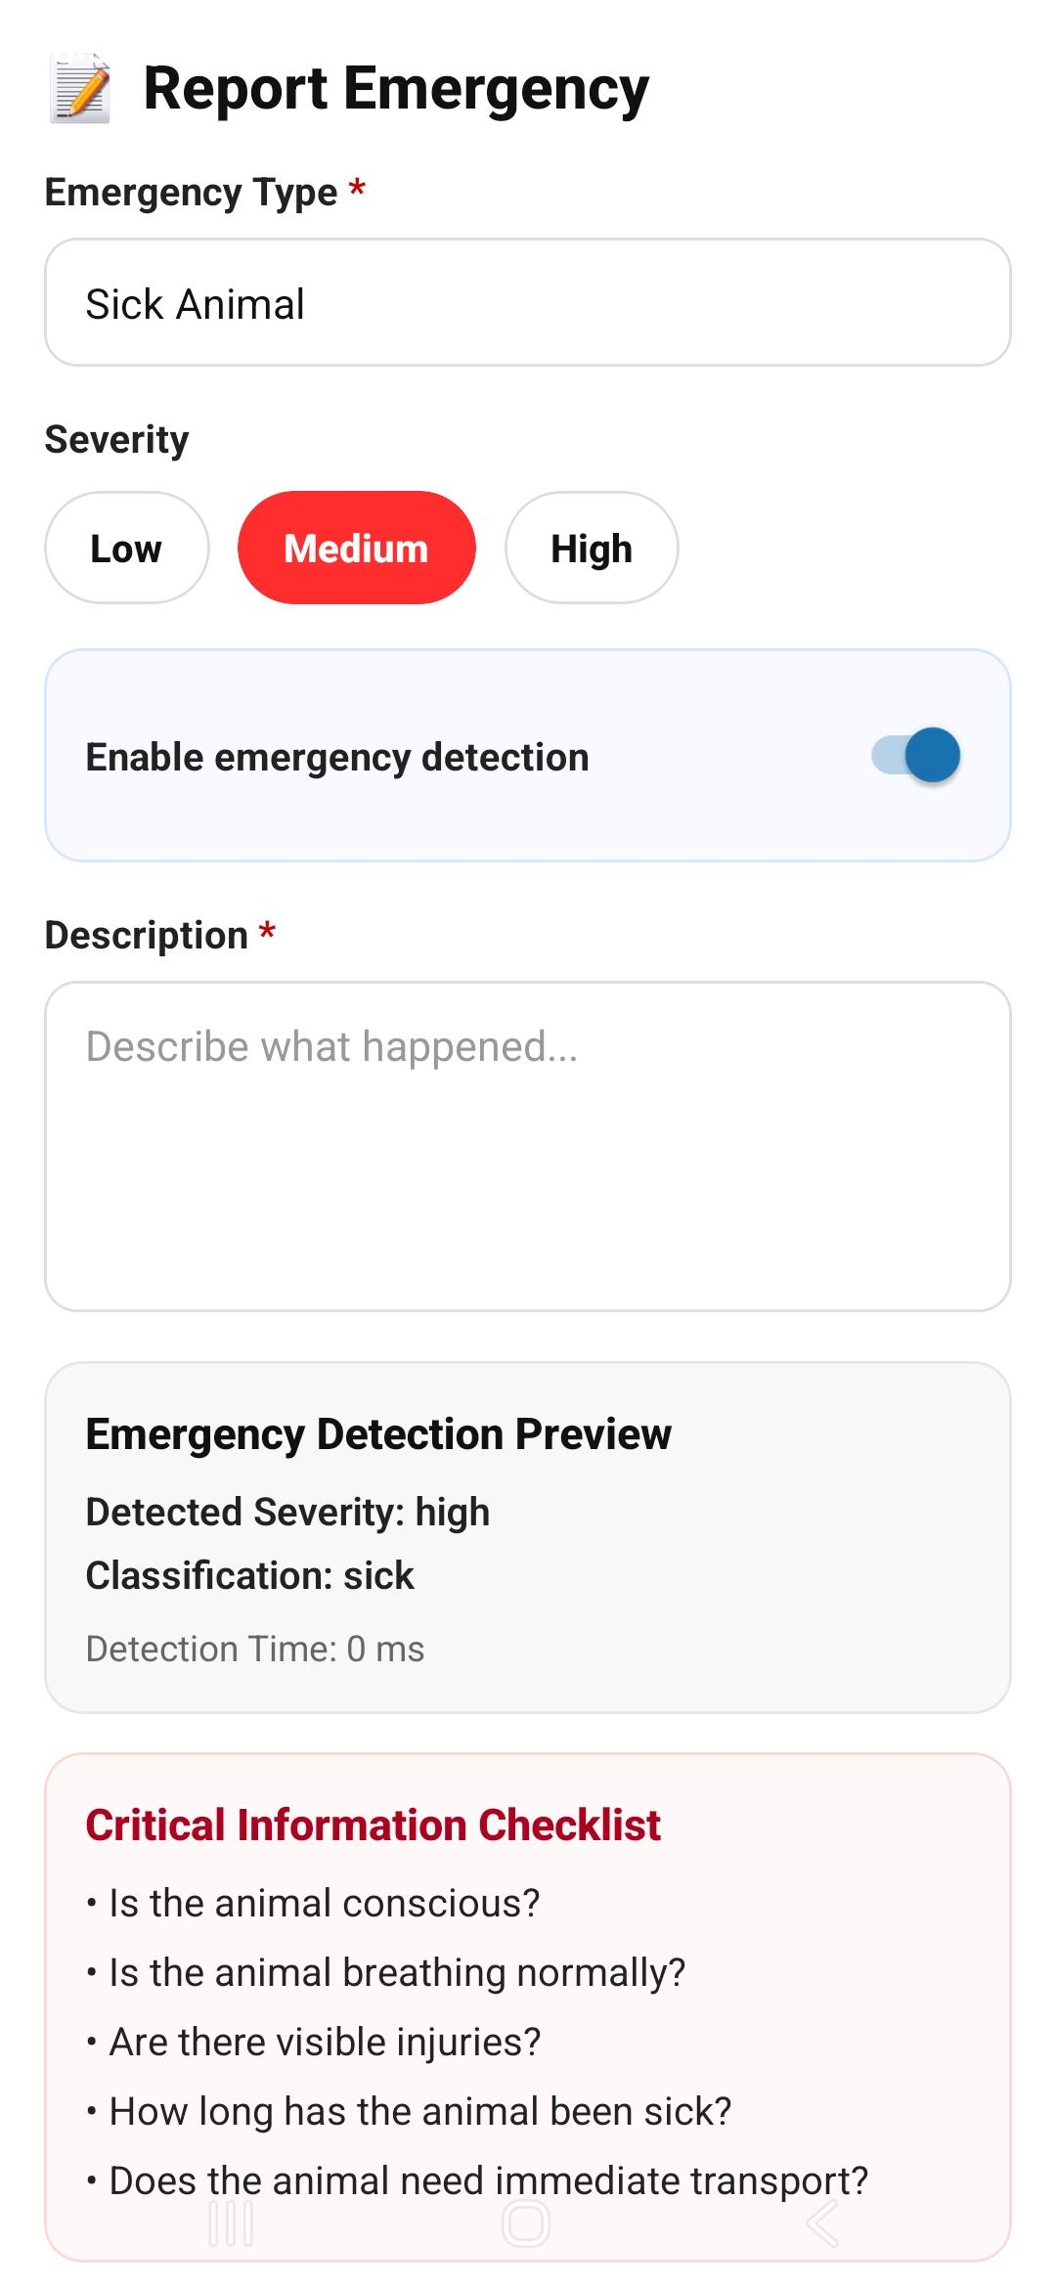
Emergency Screen

Slide 15
Non-emergency Screen
The service overview screens are Vaccination, Adopt / Surrender, and Spay / Neuter
The booking screen includes owner name, pet name, phone number, preferred date, optional notes, and optional GPS location.
The booking screen reads the incoming service name using useLocalSearchParams().

Slide 16
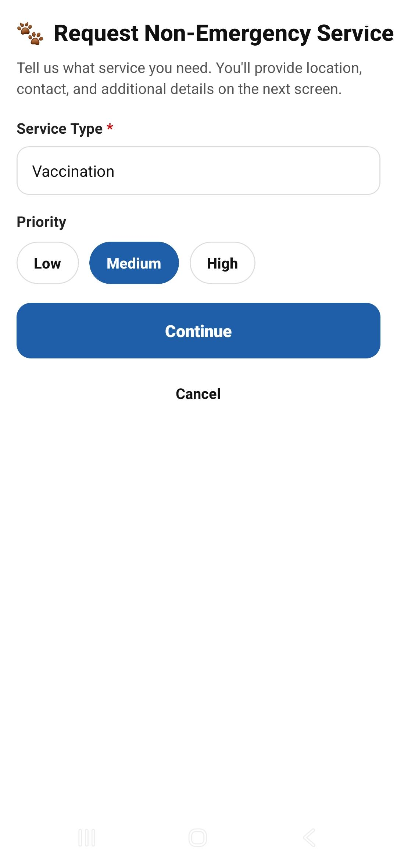
Non-emergency Screen

Slide 17
Info form screen
The info form screen is the main report submission screen after the emergency report step.
Requires at least one photo before submission.
Includes real-time validation for user input.
Reads emergency data from route params using useLocalSearchParams().
Uses a submitLockRef to prevent duplicate submissions if the user taps submit multiple times.
It compresses selected images with expo-image-manipulator before storing them in local component state.

Slide 18
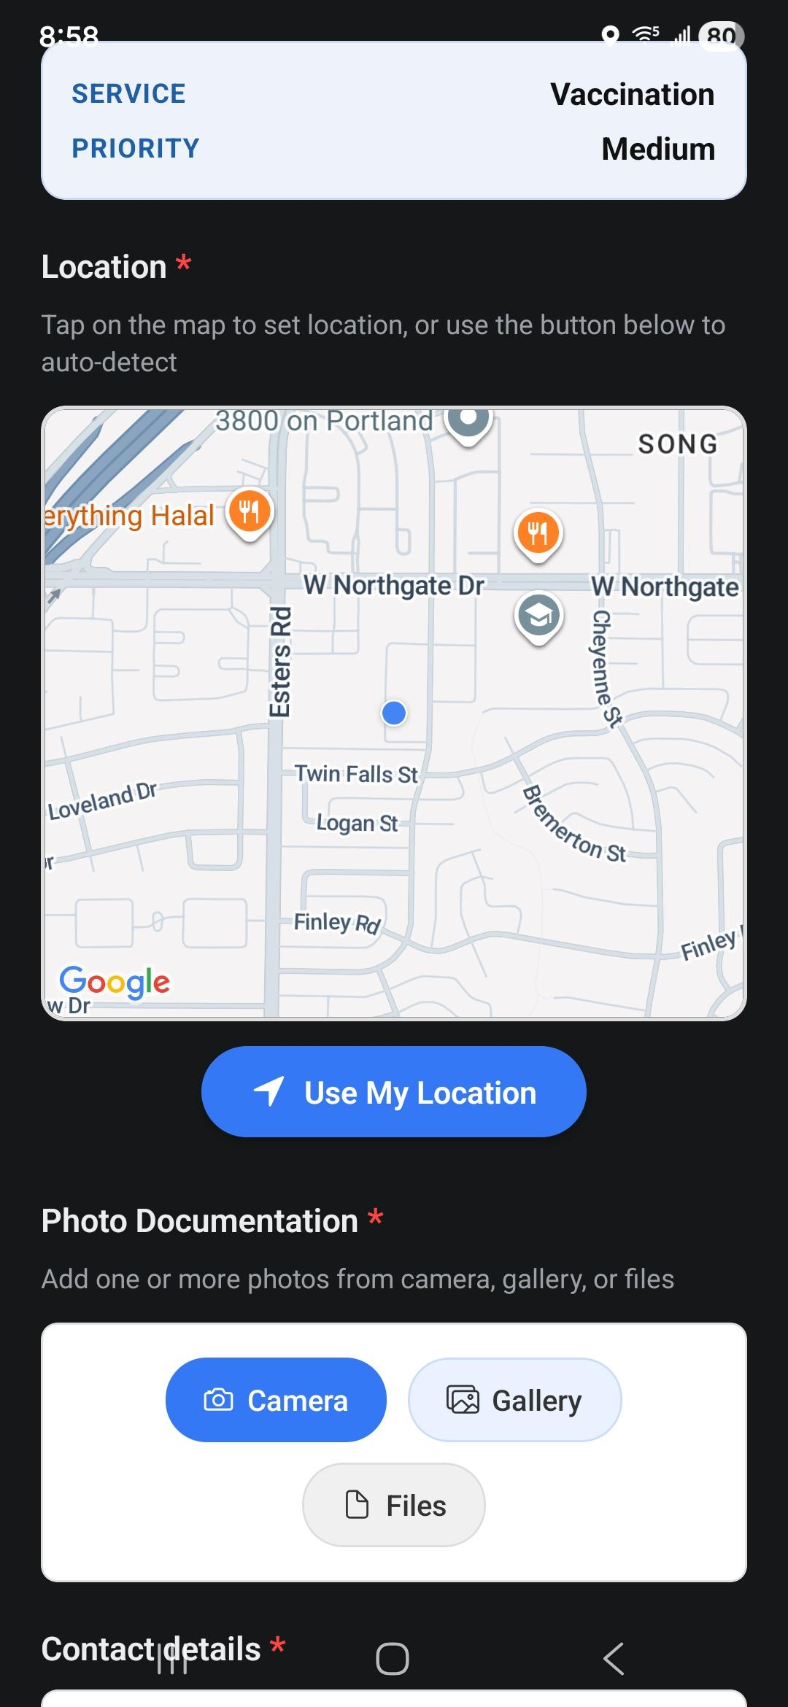
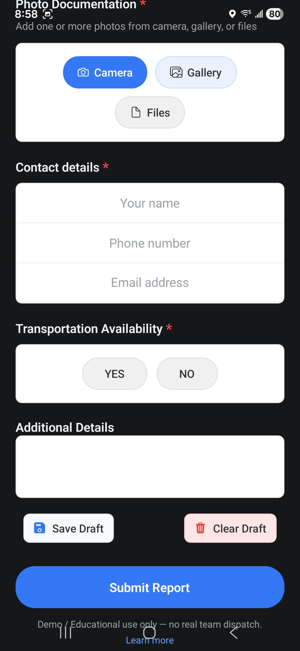
Info form screen

Slide 19
Confirmation screen
The confirmation screen shows the final request after the info form is submitted.
Includes the request ID, request tracking section, contact details, location, and buttons for next actions.
Uses the formId to decide whether the request is:
a normal submitted server request
an offline queued request
Uses NetInfo.addEventListener() and NetInfo.fetch() to track whether the device is online.
Calls getInfoFormDataById(formId) from ApiService for retrieving data to display.
Subscribes to active request count using subscribeToActiveReports(user.uid, setActiveCount)

Slide 20
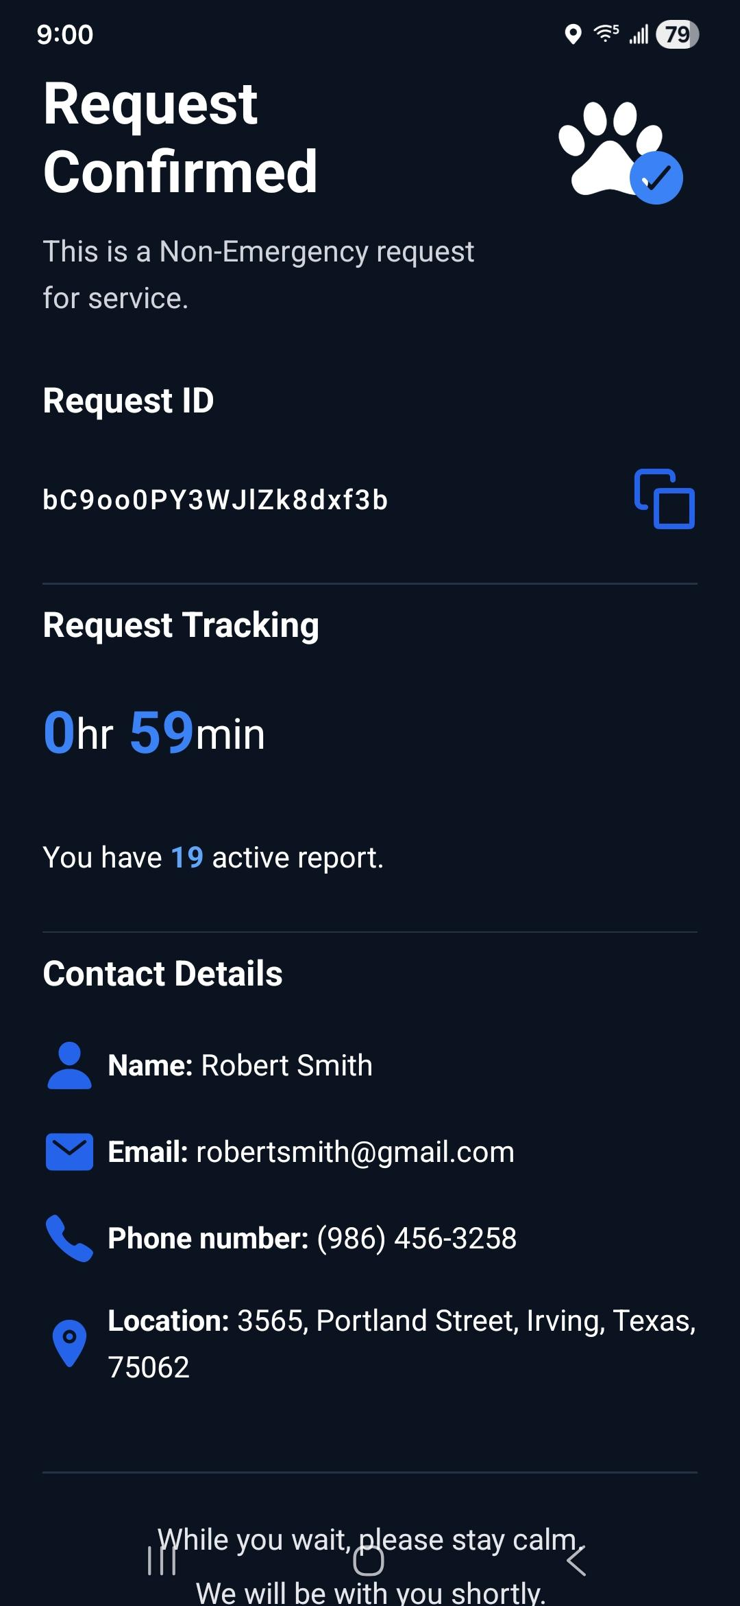
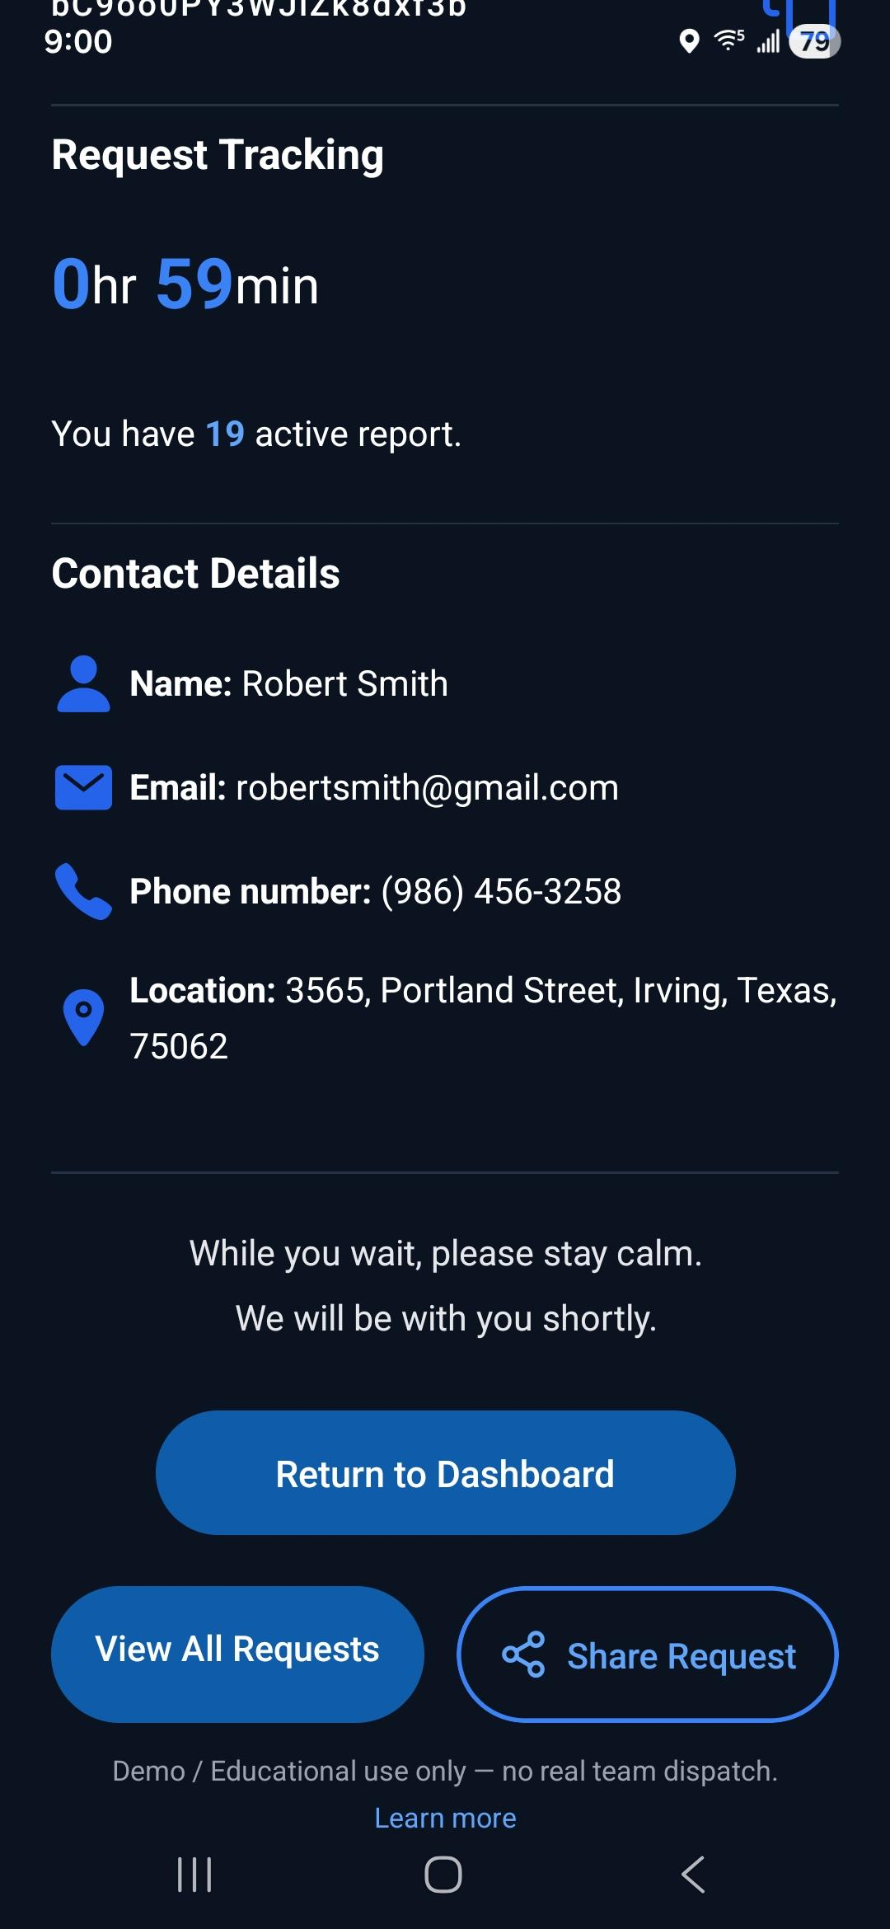
Confirmation screen

Slide 21
Firebase (backend)
The backend side is built around Firebase.
Includes Firebase Authentication for login, registration, guest access, and session handling.
Includes Firestore for storing user profiles and submitted info forms.
Includes Firebase Storage for uploaded report photos.
Main backend-based files are: firebase.ts, AuthService.ts, ApiService.ts, and RateLimiter.ts.
Includes offline queue handling and profile caching with AsyncStorage.

Slide 22
Firebase/backend (continued)
AuthService.ts: setDurablePersistence(), signInAsGuest(), register(), login()
ApiService.ts: userProfileCacheKey(), loadQueuedInfoForms(), saveQueuedInfoForms(), enqueueInfoForm(), submitInfoForm(), addEmergencyReport(), getInfoFormDataById(), uploadImage(), syncQueuedInfoForms(), logoutUser(), subscribeToActiveReports(), getUserProfile(), loadCachedUserProfile(), cacheUserProfile(), clearCachedUserProfile(), getUserProfileWithCache(), updateUserProfile(), getUserRequests(), deleteUserAccount()

Slide 23
Testing
The main focus of testing in this project was unit testing but integration and performance test were also performed.
Testing was done using Jest as the test runner and React Native Testing Library for rendering screens and simulating user actions
From the latest test run :
16 test suites passed
127 individual test cases passed
0 failed
Time: 9.866 s
The coverage summary is:
Statements: 92.08%
Branches: 80.58%
Functions: 86.59%
Lines: 93.93%

Slide 24
Debugging
Guest account info forms were not being submitted.
After debugging, the issue was that the user id for guest accounts were not being generated properly and the accounts couldn’t be tracked.
Duplicate submission because of old cache from the offline forms not yet deleted
Fixed by controlling when sync runs and ensuring queue is processed in a stable way
Initial APK crashes
Fixed by adding google maps api key on .env variable and also enabling sha-1 fingerprint so it would have added safety.

Slide 25
Debugging(continued)
File structure change among team members triggered unpredicted errors occasionally
Submission would fail silently or with crashes
Fixed by allowing offline submissions, updating data models, integrating proper
data transfer between emergency/nonemergency files and info form screen, etc.
The general approach used was:
Note the issue at hand
Add logs to track where the flow breaks
Isolate the problem (UI vs logic vs backend/firebase)
Fix the issue

Slide 26
Deployment
Configure project settings in app.config.ts (including package name and Google Maps configuration)
Set up environment variables using EAS environment variables and configure SHA-1 fingerprint in Google Cloud Console to restrict API usage to this app
Install dependencies and ensure the project builds locally without errors
Log in to Expo using EAS CLI
Run “npx expo prebuild” to generate native Android project files
Configure eas.json build profiles (preview used for internal APK distribution)
Trigger build using: “npx eas-cli@latest build -p android --profile preview”
Wait for the cloud build process ( around 5-10 minutes) to complete
Download the generated APK from the EAS build link
Install and test the APK on a physical Android device
The deployed APK was verified by testing all the flows such as authentication, user profile access, form submission, emergency detection, offline handling and request confirmation.

Slide 27
Conclusion
The project successfully meets the requirements as specified by the requirement.
The testing focused on ensuring quality coverage to reach above the 80% requirement
Debugging helped fix the major as well as some minor failure points.The app can be built and run as an APK successfully.
The system is very stable and working as expected in testing conditions including development as well as APK.

Slide 28
Links
Youtube (Demo video): https://youtu.be/oRksk3ox13Y?si=4SDLCr1mBIAWf0G4
Github: https://github.com/rheamalpekar/PetGuard.git
Expo download link(temporary only, expires): https://expo.dev/accounts/spandammahat00/projects/PetGuardTeamProject/builds/82171c81-bd1a-444f-8e6f-b0a5dc8681e6
Google drive(permanent apk): https://drive.google.com/file/d/12ilVOkJv6e2lEqRnMSZFREdrZMEfPMhg/view?usp=drivesdk

Slide 29
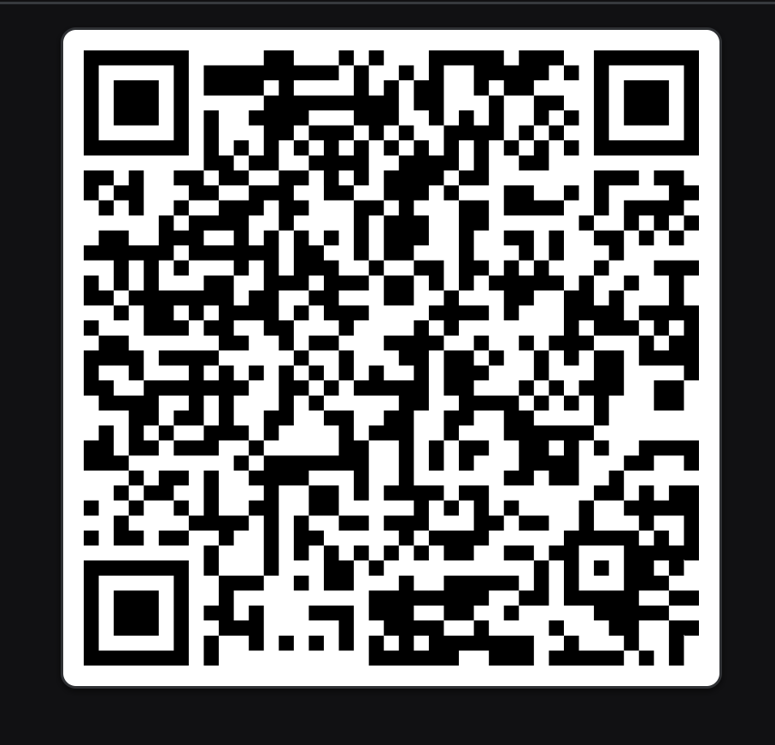
QR code

Slide 30
Thank You

